Slide 1
Are Non-Dominant Vertebral Arteries More Prone to Dissection?
Oliveira V, Basilio G, Almeida V, Soares F, Gil I
Laboratório de Hemodinâmica Cerebral – S. Neurologia
Hospital Santa Maria , Lisboa - Portugal

Slide 2
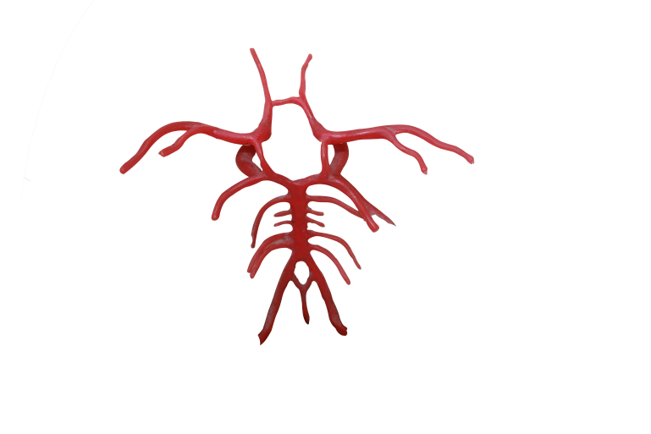
Vertebral Artery Dissections
Vertebral arteries dissections is the cause of about 2 % of all Vertebro-Basilar strokes.
Most of them occur spontaneously in young population
They seem to occur more frequently in hipoplastic vessels

Slide 3
Vertebral Artery Dissections
AIM
To identify the prevalence of the different imaging patterns.
To investigate the agreement between hemodynamic alterations evaluated by ultrasound and the imaging aspects.
To Investigate the possible association between dominance and dissection.

Slide 4
Limitations
Rectrospective Study
Small sample size
Subjectivity of criteria for “dominance”
(All the images were interpreted by the same radiologist)

Slide 5
Methods
Consecutive, rectrospective series of cases of Vertebral Arteries evaluated at an ultrasound unit in a tertiary hospital
N= 33
3 = excluded because insufficient information

Slide 6
Demography
Male = 73.3 (22)
Female = 26.7 (8)
Age
Median= 47y (26y-76y)

Slide 7
Results
All patients were evaluated by one imaging method presenting evidence of vertebral dissection
MR= 44.8% (13)
Angiogram= 48.3% (14)
CT= 6.9% (2)

Slide 8
RESULTS Imaging
Mural Haematoma
6,8% (2)others
20,7% (6)
intimal Flap
3,4% (1)
44,8% (13)
3,4% (1)
oclusion
72,4% (21)
48,3% (14)
No signs
Pseudoaneurysm
stenosis
Notes:
NÃO ESQUECER DE DEFINIR SINAIS DIRECTOS E INDIRECTOS!!!!
I_sinais_directos
I_sinais_indirectos
Hematoma mural 20,7% (6)
2 doentes sem estenose ou oclusão apresentavam sinais de flap intimal e pseudoaneurisma
Pseudoaneurisma 3,4% (1)
oclusão 44,8% (13)
Flap intimal 3,4% (1)
estenose 48,3% (14)
sem sinas directos 72,4% (21)

Slide 9
RESULTS
Ischemic Stroke %, (n)
Brain Stem 20 (6);
Cerebellum 36.7 (11);
Brain Stem + Cerebellum 36.7% (11);
Thalamus 3.3 (1);
No lesion: 3,3 (1)
 | n | %
Left VA | 13 | 44.8
Right VA | 13 | 44,8
Bilateral | 2 | 6,9
Basilar | 1 | 3,4
Notes:
No doente que não tinha avc via-se um flap intimal em RM, com fluxo de alta resistência no doppler e a doente tinha queixas de cervicalgia.

Slide 10
RESULTS
Dominant Artery – Subjective assimetry in diameter to the non-affected segments
Hypopastic Artery: diameter ≤ 2mm
6.9% (n = 2)
 | n | %
VA Left | 9 | 36
VA Right | 6 | 24
Simetrics | 10 | 40
(n=25)
Kappa Coefficient: 35%
Notes:
Aferidas as medições de dominancia através dos métodos de imagem
A escolha da artéria dominante era concordante nos dopplers e exames de imagem.
Em 5 doentes não foi possível avaliar a dominancia da artérial.
Coeficiente de kappa para classificação de hipoplasia – a baixa concordandcia entre as técnicas é à custa das assimetrias do calibre arterial que o doppler não vê.

Slide 11
RESULTS
3,4% (1)
Basilar
Bilateral
6.9% (2)
Non – Dominant Artery Dissection
Left
44.8% (13)
Right
P = 0.027
44.8% (13)

Slide 12
RESULTS
Ultrasound
Direct Signs %, (n):
Double lumen 6.7%; (2)
20% (6)
Stenosis
43.3% (13)
Oclusion
36.7% (11)
6 patients didn’t show hemodynamic abnormalities

Slide 13
Conclusions
Diagnosis of dissections of the vertebral arteries is a difficult issue since frequently no specific imaging aspects are identified.
In our series:
Cervical Color Duplex exams were in agreement with the imaging diameter to identify dominance of vertebral arteries (Kappa 35%).
In cases of Vertebral assimetries, dissections ocurred mainly in the non-dominant one. (p=0.02)

Slide 14
Thank you

